Slide 1
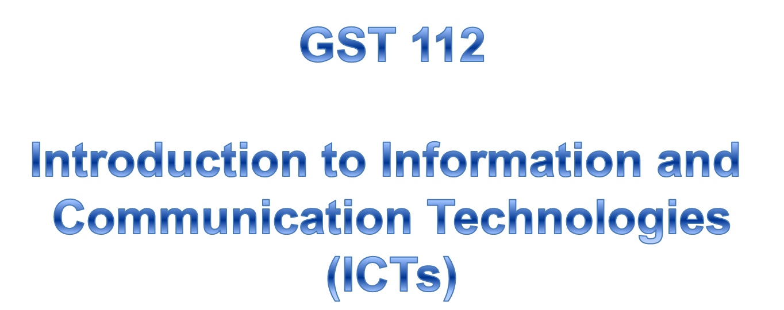


Slide 2
General Objectives
The main objectives of this module are to have you:
Acquaint with the Historical Development of Computers
Understand the different components of the computer hardware
Understand how software relates to the operation of the computer
Appreciate how the computer is related to its networked environment
Understand how data is stored and manipulated

Slide 3
Unit One: Development of Modern ICT
By the end of this unit student will be able to:
Know the different stages of computer development
mention the pioneers involved in the development of computers
Categorise the development into generations
Describe the importance ICT in education

Slide 4
Definition of Terms
ABC – Atanasoff Berry Computer
ENIAC - Electronic Numerical Integrator and Computer
EDVAC - Electronic Discreet Variable Computer
EDSAC - Electronic Delay Storage Automatic Calculator
UNIVAC - Universal Automatic Computer

Slide 5
Brief History of Computing
Computer history starts from basic adding machine to the present
sophisticated devices, which can be summarised:
14th Century. - Abacus - an instrument for performing calculations
by sliding counters along rods or in grooves.
17th Century - Slide rule - William Oughtred, an English clergyman invented a manual device used for calculation that consists in its simple form of a ruler and a movable middle piece which are graduated with similar logarithmic scales.
1642 – Pascaline - a mechanical calculator built by Blaise Pascal.
1671 – Leibniz Machine a calculating machine designed by a German mathematician-philosopher Gottfried Wilhelm von Leibniz.
1804 - Jacquard loom - a loom programmed with punched cards
invented by Joseph Marie Jacquard .

Slide 6
1850 - Difference Engine, Analytical Engine--Charles Babbage
and Ada Byron.
1939 -1942 - Atanasoff Berry Computer - built at Iowa State by Prof.
John V. Atanasoff and a graduate student Clifford Berry.
1946 – ENIAC - World's first electronic, large scale, general-purpose
computer, built by Mauchly and Eckert, and activated at the University
of Pennsylvania in 1946.
1940s - Colossus - Alan Turing's vacuum tube computing machines
broke Hitler's Enigma codes.
Early 1940s - 1949 - The First Stored-Program Computer (EDVAC) in the works but was overtaken by Manchester Mark I designed by Max Newman in 1948 to become the First. In 1949 Maurice Wilkes completed the EDSAC two years ahead of EDVAC, to become first stored-program computer in general use.
1950s - 1960s - UNIVAC - "punch card technology" The first commercially
successful computer, introduced in 1951 by Remington Rand.

Slide 7
1978 to 1986 - Large Scale Integration (LSI); Alto--workstation with mouse; Apple, designed by Steve Wozniak, Steve Jobs.
1992 - Bill Gates' Microsoft Corp. released Windows 3.1, an operating system that made IBM and IBM-compatible PCs more user-friendly by integrating a graphical user interface into the software.

Slide 8



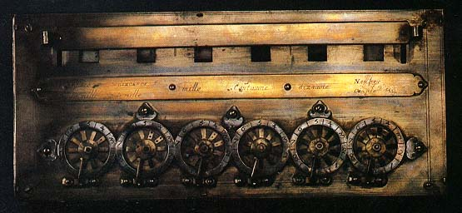
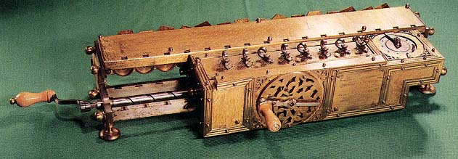
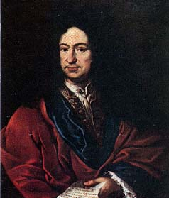
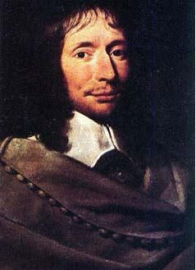
The Pioneers and their Inventions
Abacus
William Oughtred
Slide Rule
Pascaline calculator
Leibniz machine
Gottfried Leibniz
Blaise Pascal

Slide 9
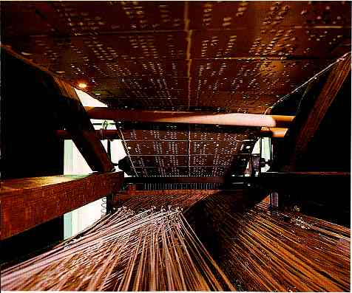
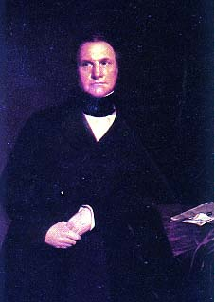
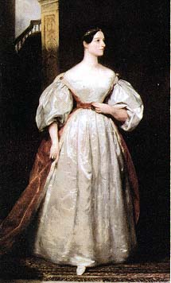
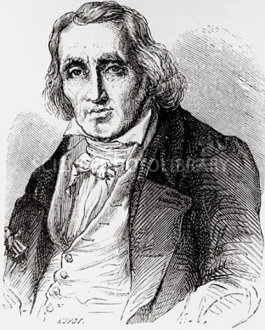
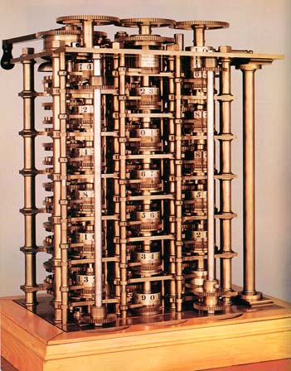
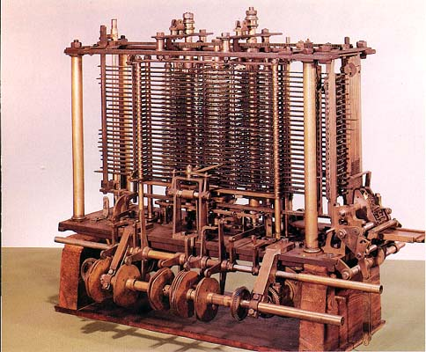
The Pioneers and their Inventions
Jacquard Loom
Ada Byron
Charles Babbage
Analytical engine
Joseph Marie Jacquard
Difference engine

Slide 10



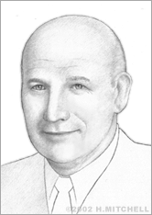
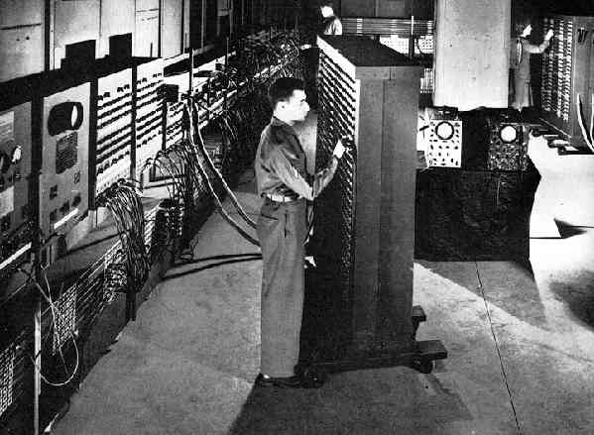
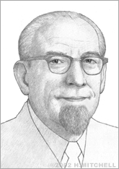
The Pioneers and their Inventions
John Atanasoff
Atanasoff Berry Computer
Clifford Berry
John Presper Eckert
ENIAC
John W. Mauchly

Slide 11
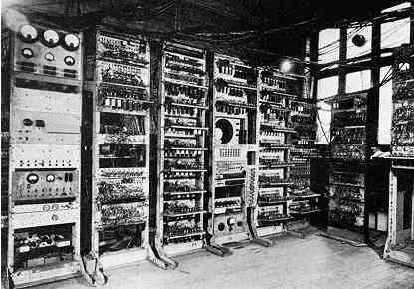
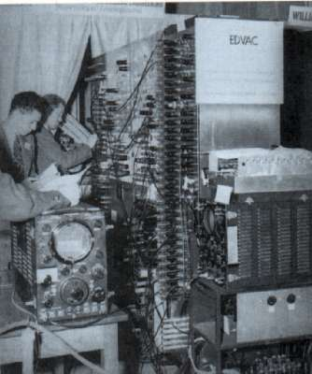
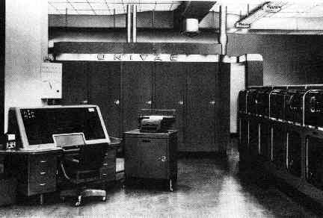
The Pioneers and their Inventions
Mark I
EDVAC
UNIVAC

Slide 12
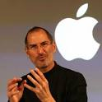


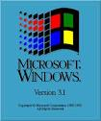
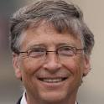
The Pioneers and their Inventions
?
?
?

Slide 13
The History of the Internet
The Internet, originally started as a Project - the ARPAnet (Advanced Research Projects Agency network), began as a military computer network.
The National Science Foundation (NSF) today, provided the catalyst for the expansion of the Internet.
Universities were early users of the Internet.
In 1995, large commercial Internet service providers (ISPs), such as MCI, Sprint , AOL and UUNET, offered service to large number of customers.
Today the Internet has grown past the initial thoughts and design, both in the number of computers on it and the quantum information.

Slide 14
ICT in Education
ICT and Education are inseparable
ICT Increases access to education It provides students and teachers
new tools with which to learn and teach.
ICT has improved the quality of education – It enable teachers
to transform their practices by providing them with improved educational
content and more effective teaching methods.

